Slide 1
What Can We Cook

Slide 2






Meet The Team
Darell Isaac Sam
Web App Backend + Mobile App
Ben Oz Elhadad
UX/UI
David Lucero
Docs/QA
Pseudocode Warriors
Nicholas Smit
Backend/Infrastructure
Sebastian Lopez
Backend Development
Stanley Lu
SQL Database + Ideation

Slide 3

Project Description
Overview:
A recipe planner web app built with FastAPI + HTML/CSS
Users add what’s in their fridge/pantry
The app suggests recipes you can cook now
Auto-generate a Smart Grocery List if missing key ingredients for the recipe
Recipes include step-by-step instructions as well as optional videos.

Slide 4
Core Functions
Recipe Management
Browse/search recipes (title, ingredient, tag).
Recipes include: title, description, servings, total time, ingredients, steps.
Instructional Support
Step-by-step page (ordered steps).
Optional video embed.
Smart Grocery List
When choosing a recipe, missing ingredients will be marked.
List is exportable.
User marks “Purchased” to update.
Pantry
Users maintain a saved pantry in the app.
Simple add/remove with quantities optional.
Used by search (“show what I can cook now”).

Slide 5
Secondary Features
Low Effort
Scale servings
Favorites/Bookmarks
Tags/Filters
Moderate/High Effort
Cooking Mode: display instructions one step at a time.
Users can submit new recipes that appear only after approval.

Slide 6
Gantt Chart
September
October
November
Week 1
Week 2
Week 3
Week 4
Week 5
Week 6
Week 7
Week 8
Week 9
Week 10
Deliverable 1
Deliverable 2
Deliverable 3
Deliverable 4
Deliverable 5
Due Dates
September 1
September 21
November 2
November 16
November 23
‹#›

Slide 7
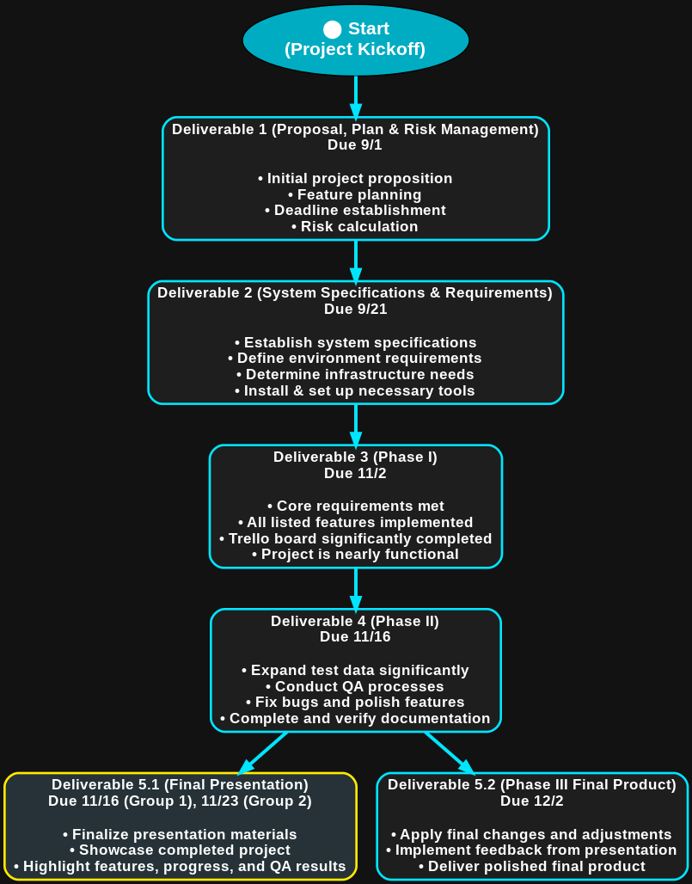
PERT Chart

Slide 8
RACI Matrix Project Management
This is a RACI diagram. It shows which roles are responsible, accountable, consulted, or informed at each stage of the project.
Backend
UI/UX
SQL Database
Docs/QA
R
Responsible
Accountable
Consulted
Informed
A
Deliverable 1
C
C
C
C
C
Deliverable 2
R
C
R
A
I
Deliverable 3
A
R
R
A
Deliverable 4
R
R
I
A
Deliverable 5
R
R
R
R

Slide 9
Risk Management
Risks | Description | Likelihood of Risk | Severity | Affected Areas | Mitigation Action
Scope Creep | Adding too many extra features overwhelms the team and delays the delivery | High | High | Schedule and overall team workload | Lock scope to core functions. Leave other features as possible additions after completing the necessary work
Skills Gaps | Team members could have differing levels of programming causing mismatch between frontend and backend development | Low | Medium | Functionality and Quality of the product | QA testing each other's work for uniformity and functionality
Delays | Tasks take longer to complete than expected | Medium | High | Schedule and Deliverables | Weekly milestones. Using Trello effectively for tasks
Team member Availability | Conflicting schedules, illness, or personal events could delay tasks completion | Medium | High | Schedule and Team Workload | Make a clear distinction in responsibilities. Communicate as quickly as possible if unforeseen events occur to ensure workflow is not disrupted
Version Control | Merge conflicts or code overwritten/lost if Git workflow is not aligned | Medium | High | Productivity and Stability | Have weekly merges and checks.

Slide 10
Risk Assessment
01
Scope Creep
Adding too many extra features overwhelms the team and delays the delivery. This can affect our ability to meet due dates for deliverables as well as affect our team workload.
02
Delays
Task may take longer to complete than expected due to many unpredictable factors. This could affect our intended schedule and ability to produce timely deliverables.
03
Team Member Availability
Conflicting schedules, illnesses, or personal events and/or responsibilities could delay task completion or decrease our ability to cooperate. This could negatively affect our teams’ schedule and workload.

